Slide 1
Operating Systems

Slide 2
A little history
Early computers were initially single user systems and evolving from hard wired programs to punched cards, magnetic tape and other methods of feeding a new program into the computer system.
Using a computer meant signing up for a time slot Actually walking up to the computer center at the appointed time, sitting in front of a single monitor and working on your program.
  Each user was allocated a minimum 15-minute slot
  They usually spent 10 minutes in setting up the equipment to do their computation ... By the time you got your calculation going, you may have had only 5 minutes or less of actual computation completed—wasting two thirds of the time slot.
http://citeseerx.ist.psu.edu/viewdoc/download?doi=10.1.1.104.1524&rep=rep1&type=pdf

Slide 3
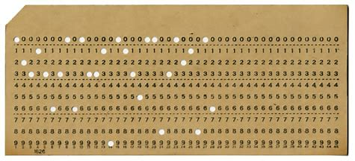
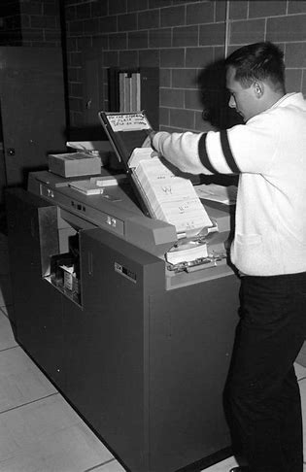
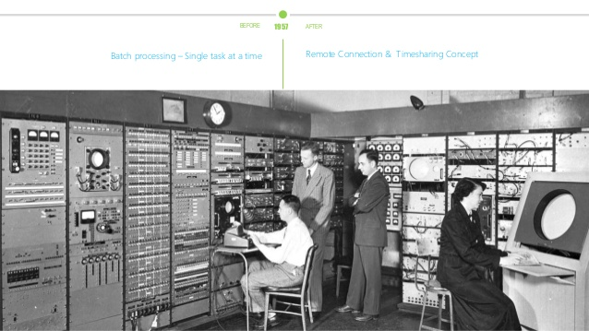
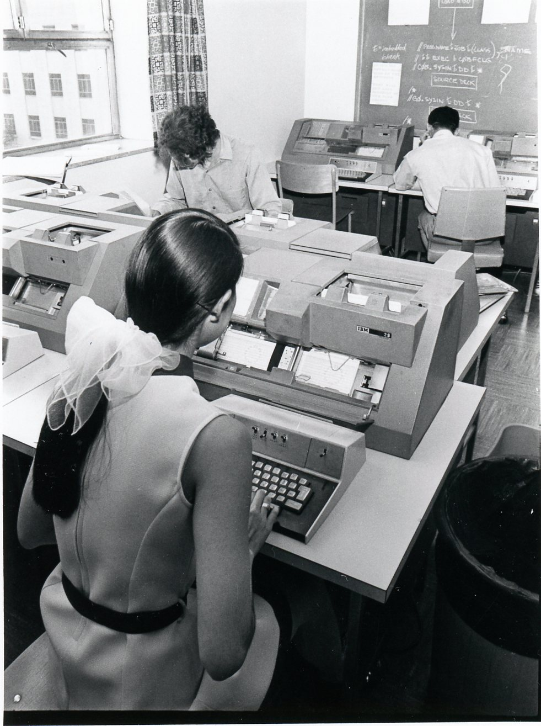
Costs …
The economic cost of all the setup time was staggering. Companies were charging $300 per hour for computer time on an IBM 701 in 1954 dollars, that's $2,866 in 2020 dollars!
  The first operating systems were designed to fix this problem.
  Automatically load a new program when the currently executing program completed or crashed.
  This evolved into a revolutionary OS mechanism called ‘Batch Processing’

Slide 4
State of the art … circa 1970s and back again
Timesharing systems
  Remote terminals wired to mainframes
  Your good friend the command line/ console!
Early real-time systems
  Tiny (often custom) OS’s to run machines .. .like the Apollo guidance system!
Centralized computing, and all-control to the OS was the approach
In the 80s, Personal Computers drove a push for simpler (User) Interfaces (vs. interfaces for experts), and Computing became decentralized
Today? OS and computing trends are shifting again
  Centralization: Cloud computing
  Costs: Hourly prices range from $0.011/hour to $0.27/hour ($94/year to $2367/year).
https://aws.amazon.com/emr/pricing/

Slide 5
Types of Operating Systems
Whatever the user model, or commercial model, the Operating System drives the capabilities of the computer system.
The OS capabilities often set boundaries for your application architecture
Types of OS architectures
  Monolithic systems
  Layered systems
  Microkernels

Slide 6
Monolithic
Software
Early computer systems
Basic embedded controllers circa 1980s
Kernel

Slide 7
[Semi]-Layered
Theory
DOS
Application
Application
Each layer talks to the next layer
System Programs (resident)
System Programs (resident)
Device Drivers
Device Drivers
BIOS
BIOS
‘BIOS’ is in chips, and ‘boots’ the OS
Basic Input/ Output Services
Basic Input/ Output Services

Slide 8
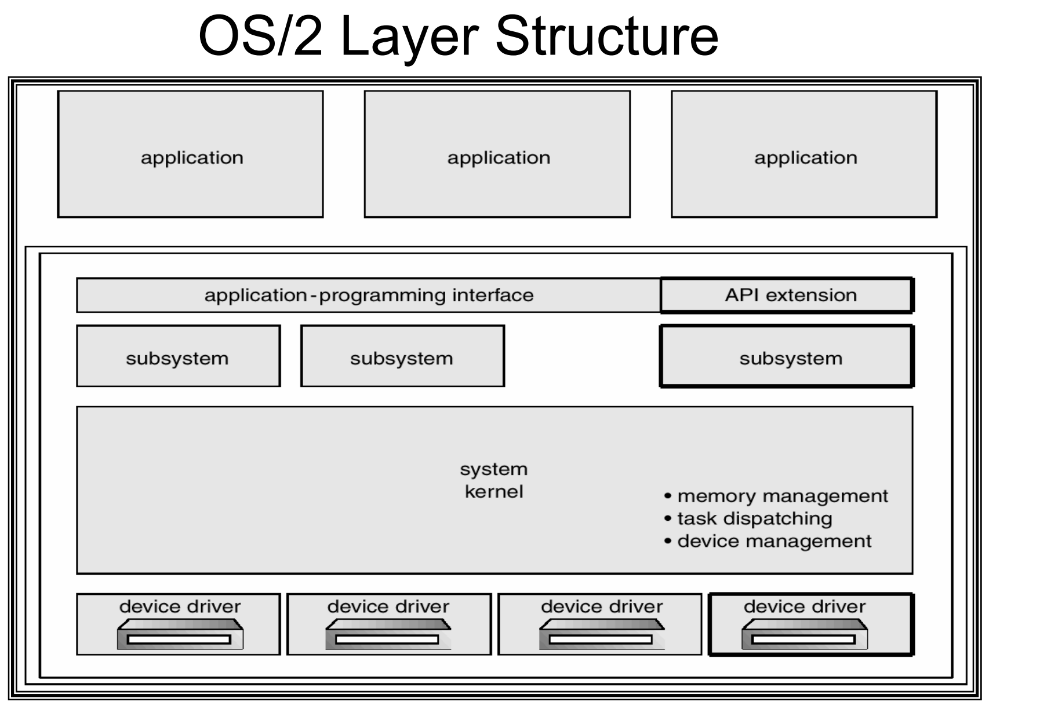
Improved OS architectures
Enforced layers
Advantages?
Isolation
Stability
Notes:
But why did OS/2 disappear? Lack of applications; no backward compatibility with suite of applications. But was the right direction

Slide 9
Kernel Space and User Space …
Memory:
User space [Applications run here, cannot access kernel]
Kernel Space (protected) [Core low level OS functions with full access to HW]
Modern OS’s eliminate dangers of programmer error by preventing Applications from getting to Kernel space – this is why you can no longer take down the ENTIRE computer if you are app crashes. That, plus memory management enable isolation per process
This enables multi-process programming
Multi-programmed OS With Memory Protection
• Memory protection keeps user programs from crashing one another and the OS
• Two hardware-supported mechanisms
  Address translation
  Dual-mode operation
• Each process is associated with an address space, or all the physical addresses a process can touch
• However, each process believes that it owns the entire memory, starting with the virtual address 0
• The missing piece is a translation table to translate every memory reference from virtual to physical addresses

Slide 10
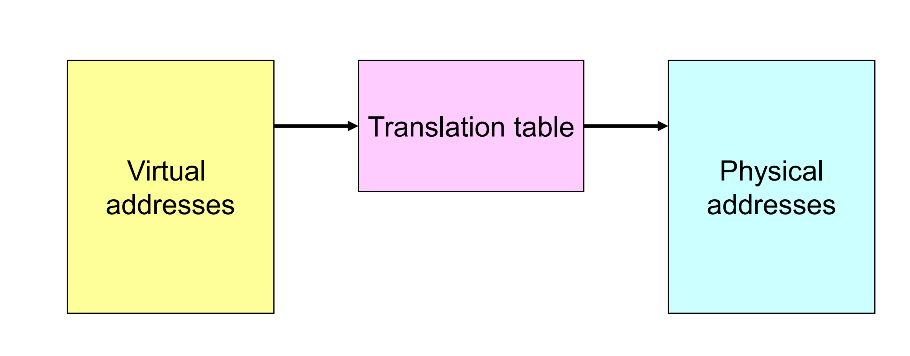
Address Translation
Why do you get kernel panic and blue-screens?
Virtual Memory
What is swap space?
Translation provides protection
  Processes cannot talk about other processes’ addresses, nor about the OS addresses
OS uses physical addresses directly
  No translations
Notes:
Usually low level drivers corrupt memory that is not meant for their use
OS frees up physical memory by saving memory, state, on HDD. It ‘swaps’ out RAM to disk (e.g. idle applications). If you have a lot of swapping, it will slow down performance

Slide 11
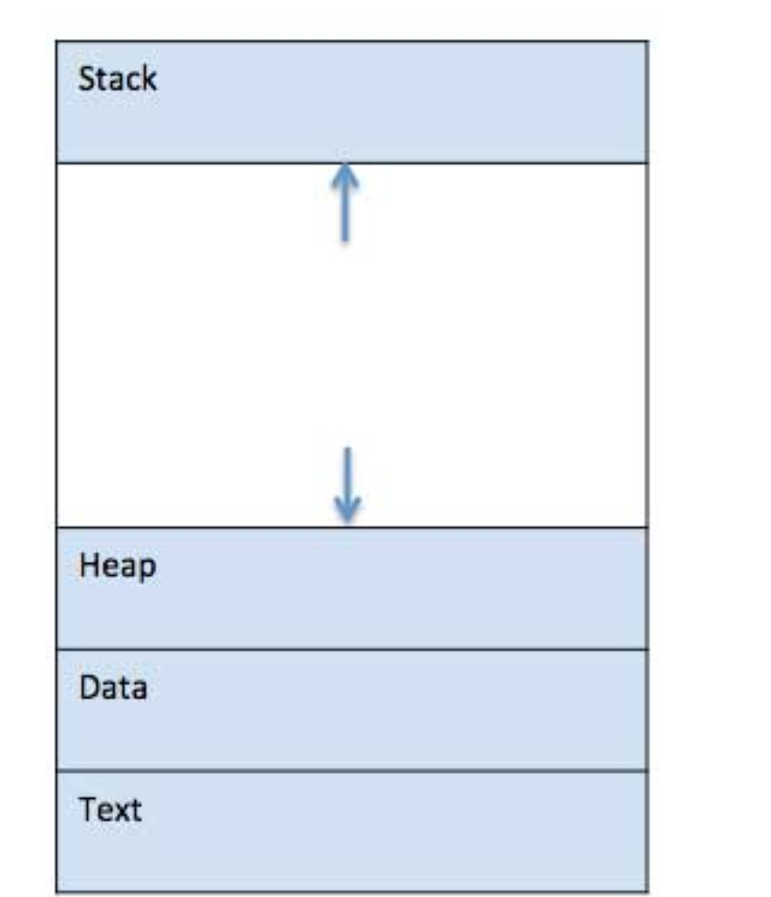
How does an application ‘run’?
 | Component & Description
1 | Stack The process Stack contains the temporary data such as method/function parameters, return address and local variables.
2 | Heap This is dynamically allocated memory to a process during its run time.
3 | Text This includes the current activity represented by the value of Program Counter and the contents of the processor's registers.
4 | Data This section contains the global and static variables.
Process vs. Thread: The above is a PROCESS!

Slide 12
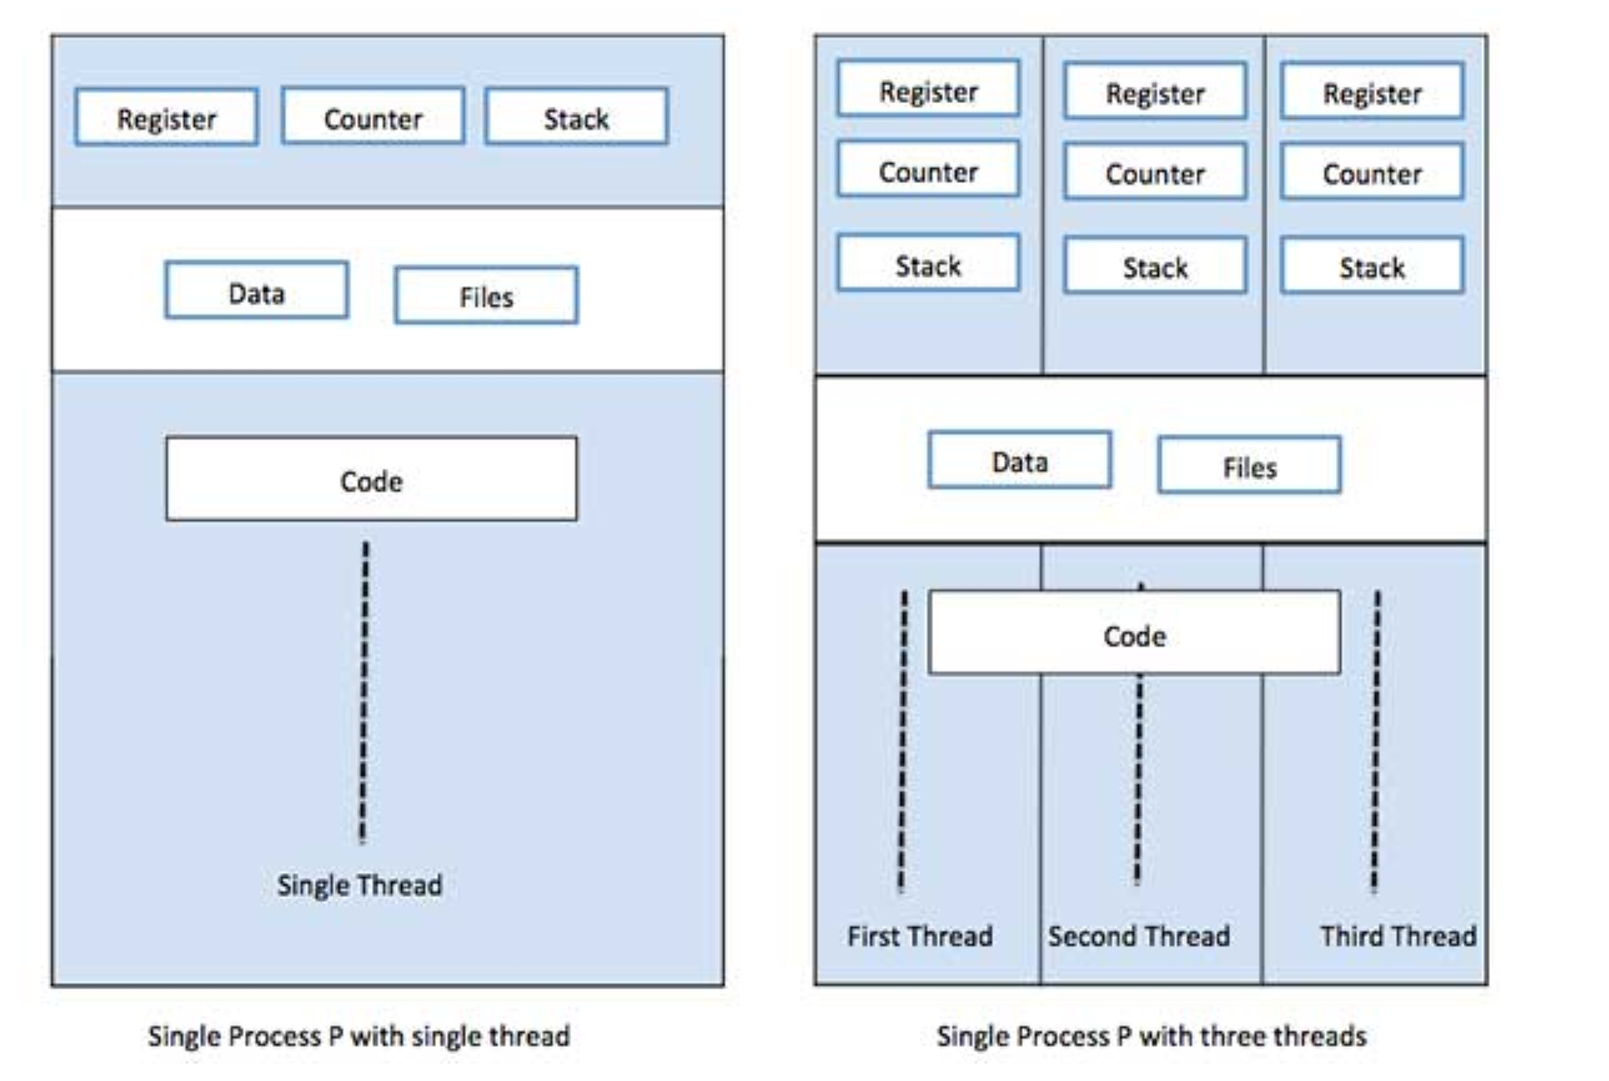
Process vs. Thread
Process | Thread
Process is heavy weight or resource intensive. | Thread is light weight, taking lesser resources than a process.
Process switching needs interaction with operating system. | Thread switching does not need to interact with operating system.
In multiple processing environments, each process executes the same code but has its own memory and file resources. | All threads can share same set of open files, child processes.
If one process is blocked, then no other process can execute until the first process is unblocked. | While one thread is blocked and waiting, a second thread in the same task can run.
Multiple processes without using threads use more resources. | Multiple threaded processes use fewer resources.
In multiple processes each process operates independently of the others. | One thread can read, write or change another thread's data.
Notes:
Architectural note: Choice of communication and process/ module separation!
https://www.tutorialspoint.com/operating_system/os_quick_guide.htm

Slide 13
Multi-processing
How does an OS run multiple applications?
Co-Operative Multiprocessing
Timesharing scheduling
Priority Pre-emptive multi-tasking
Address space isolation (see prior slides)
Technically, multiprocessing can occur w/o this … but watch out

Slide 14
Co-Operative Multitasking
All processes are memory resident
Running process has full control of CPU
It must explicitly ‘yield’ control to allow another process to run
Process 1
Process 2
Process 3
Executable code segment
Executable code segment
Executable code segment
Yield
Yield
Yield
e.g. Windows pre-Windows 95
CPU

Slide 15
Timesharing Multitasking
Processes (tasks) are assigned a ‘time to run’ (sometimes by priority)
OS Schedules a time slot for each
Runs tasks until time expires
Switches context and runs next priority process
Task 1
Task 2
Task 3
Task 4
Task 5
OS
CPU

Slide 16
Priority Pre-emptive Multitasking
Processes (tasks) are assigned a priority
OS Schedules a time slot for each
Runs tasks until time (per priority) expires
Interrupt triggers OS
Switches context (under control of OS) and runs next priority process (pre-empts process, even in the middle of execution)
Task 1
Task ID | Priority
1 | 1
2 | 1
3 | 2
4 | 3
5 | 2
Run Pri. 1
Task 2
Run Pri. 2
Task 3
Task 5
Run Pri. 3
Task 4
OS
e.g. modern OSes: Windows, Linux, MacOS
CPU

